Slide 1
Notes:
Good evening, we are team Thomas and Friends, and today we will be presenting about our study on Singapore’s Mass Rapid Transit system. Singapore has long prided ourselves on our clean, successful and efficient transport system. And with its constant rapid expansion,

Slide 2
Problem Statement
How can we model passenger traffic at future MRT stations for enhanced urban planning strategies?
Notes:
How can we model passenger traffic at future MRT stations for enhanced urban planning strategies?

Slide 3
Connectivity For All
Singapore’s booming MRT Network has long been a priority for the nation
Since its conceptualisation in 1972, the MRT system has played an integral role in citizens’ lives
Notes:
Since its conceptualisation in 1972, the MRT system has played an integral role in citizens’ lives, with our system map constantly evolving and seeing more than 5 renditions over the past 30 years.

Slide 4
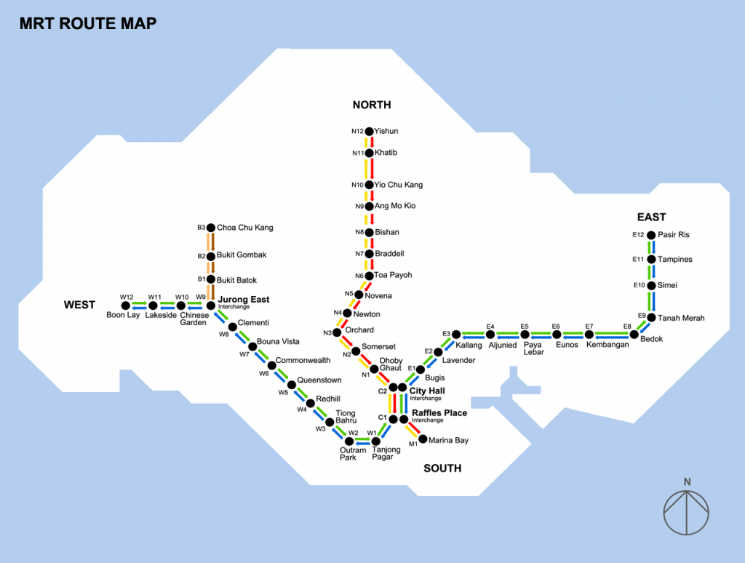
Connectivity For All
Singapore’s booming MRT Network has long been a priority for the nation
Since its conceptualisation in 1972, the MRT system has played an integral role in citizens’ lives
1990
Notes:
Since its conceptualisation in 1972, the MRT system has played an integral role in citizens’ lives, with our system map constantly evolving and seeing more than 5 renditions over the past 30 years.

Slide 5
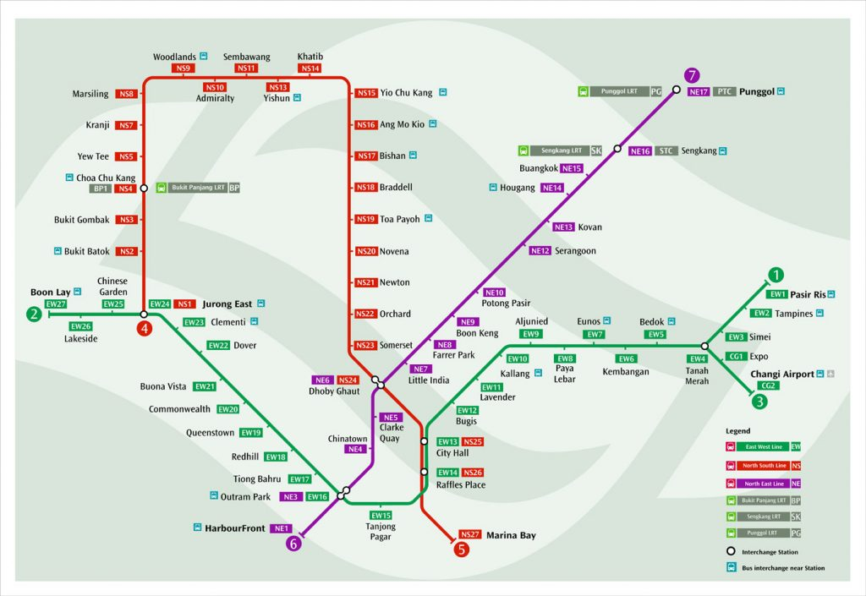
Connectivity For All
Singapore’s booming MRT Network has long been a priority for the nation
Since its conceptualisation in 1972, the MRT system has played an integral role in citizens’ lives
2003
Notes:
Since its conceptualisation in 1972, the MRT system has played an integral role in citizens’ lives, with our system map constantly evolving and seeing more than 5 renditions over the past 30 years.

Slide 6
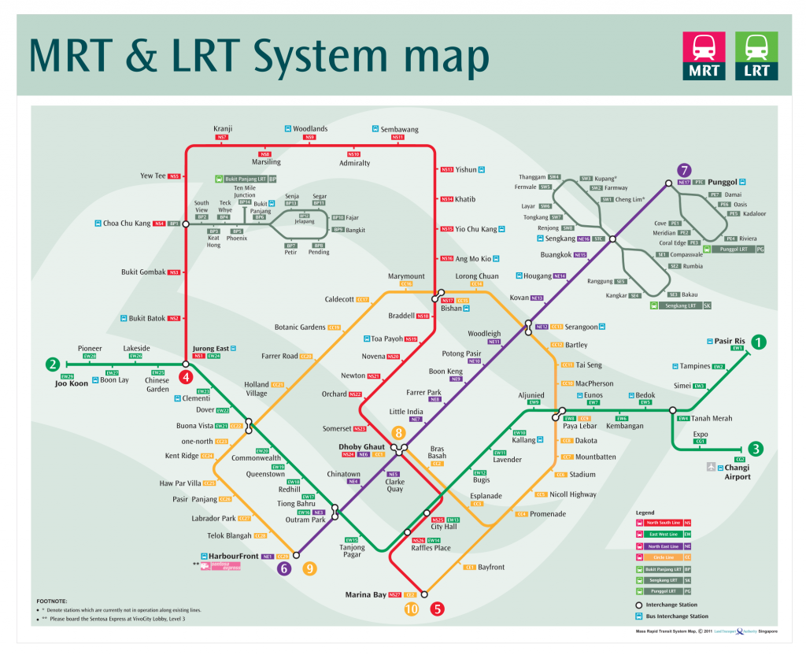
Connectivity For All
Singapore’s booming MRT Network has long been a priority for the nation
Since its conceptualisation in 1972, the MRT system has played an integral role in citizens’ lives
2009
Notes:
Since its conceptualisation in 1972, the MRT system has played an integral role in citizens’ lives, with our system map constantly evolving and seeing more than 5 renditions over the past 30 years.

Slide 7
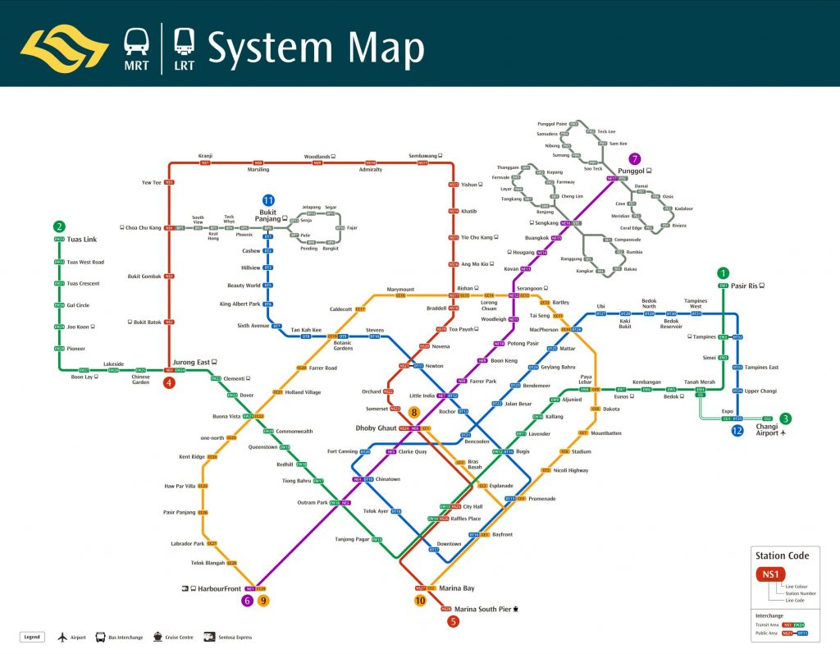
Connectivity For All
Singapore’s booming MRT Network has long been a priority for the nation
Since its conceptualisation in 1972, the MRT system has played an integral role in citizens’ lives
2013
Notes:
Since its conceptualisation in 1972, the MRT system has played an integral role in citizens’ lives, with our system map constantly evolving and seeing more than 5 renditions over the past 30 years.

Slide 8
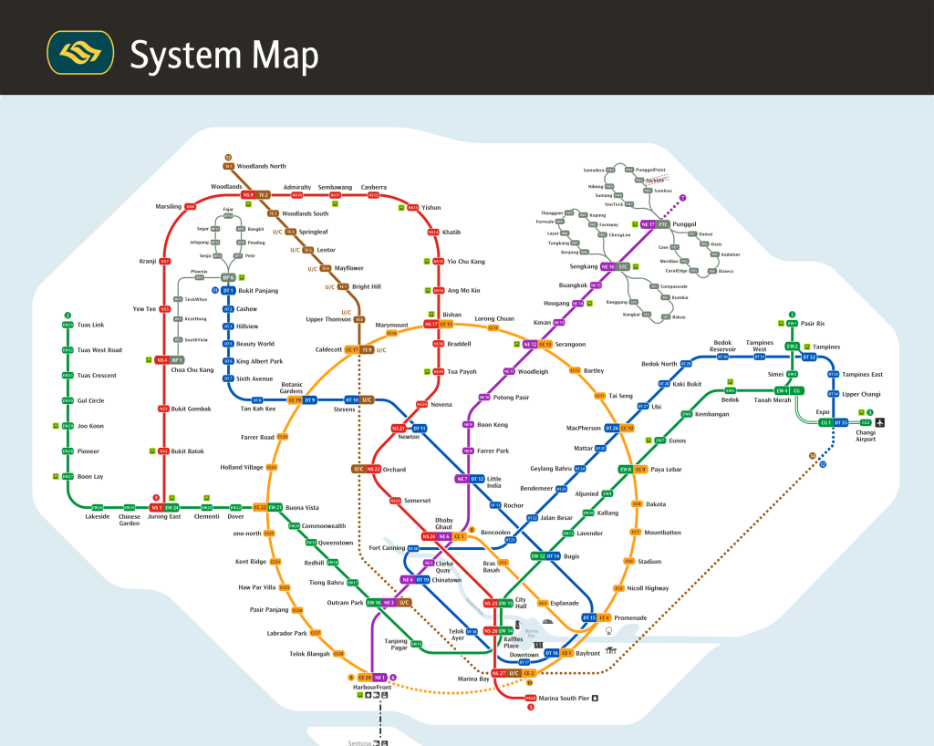
Connectivity For All
Singapore’s booming MRT Network has long been a priority for the nation
Since its conceptualisation in 1972, the MRT system has played an integral role in citizens’ lives
2020
Notes:
Since its conceptualisation in 1972, the MRT system has played an integral role in citizens’ lives, with our system map constantly evolving and seeing more than 5 renditions over the past 30 years.

Slide 9
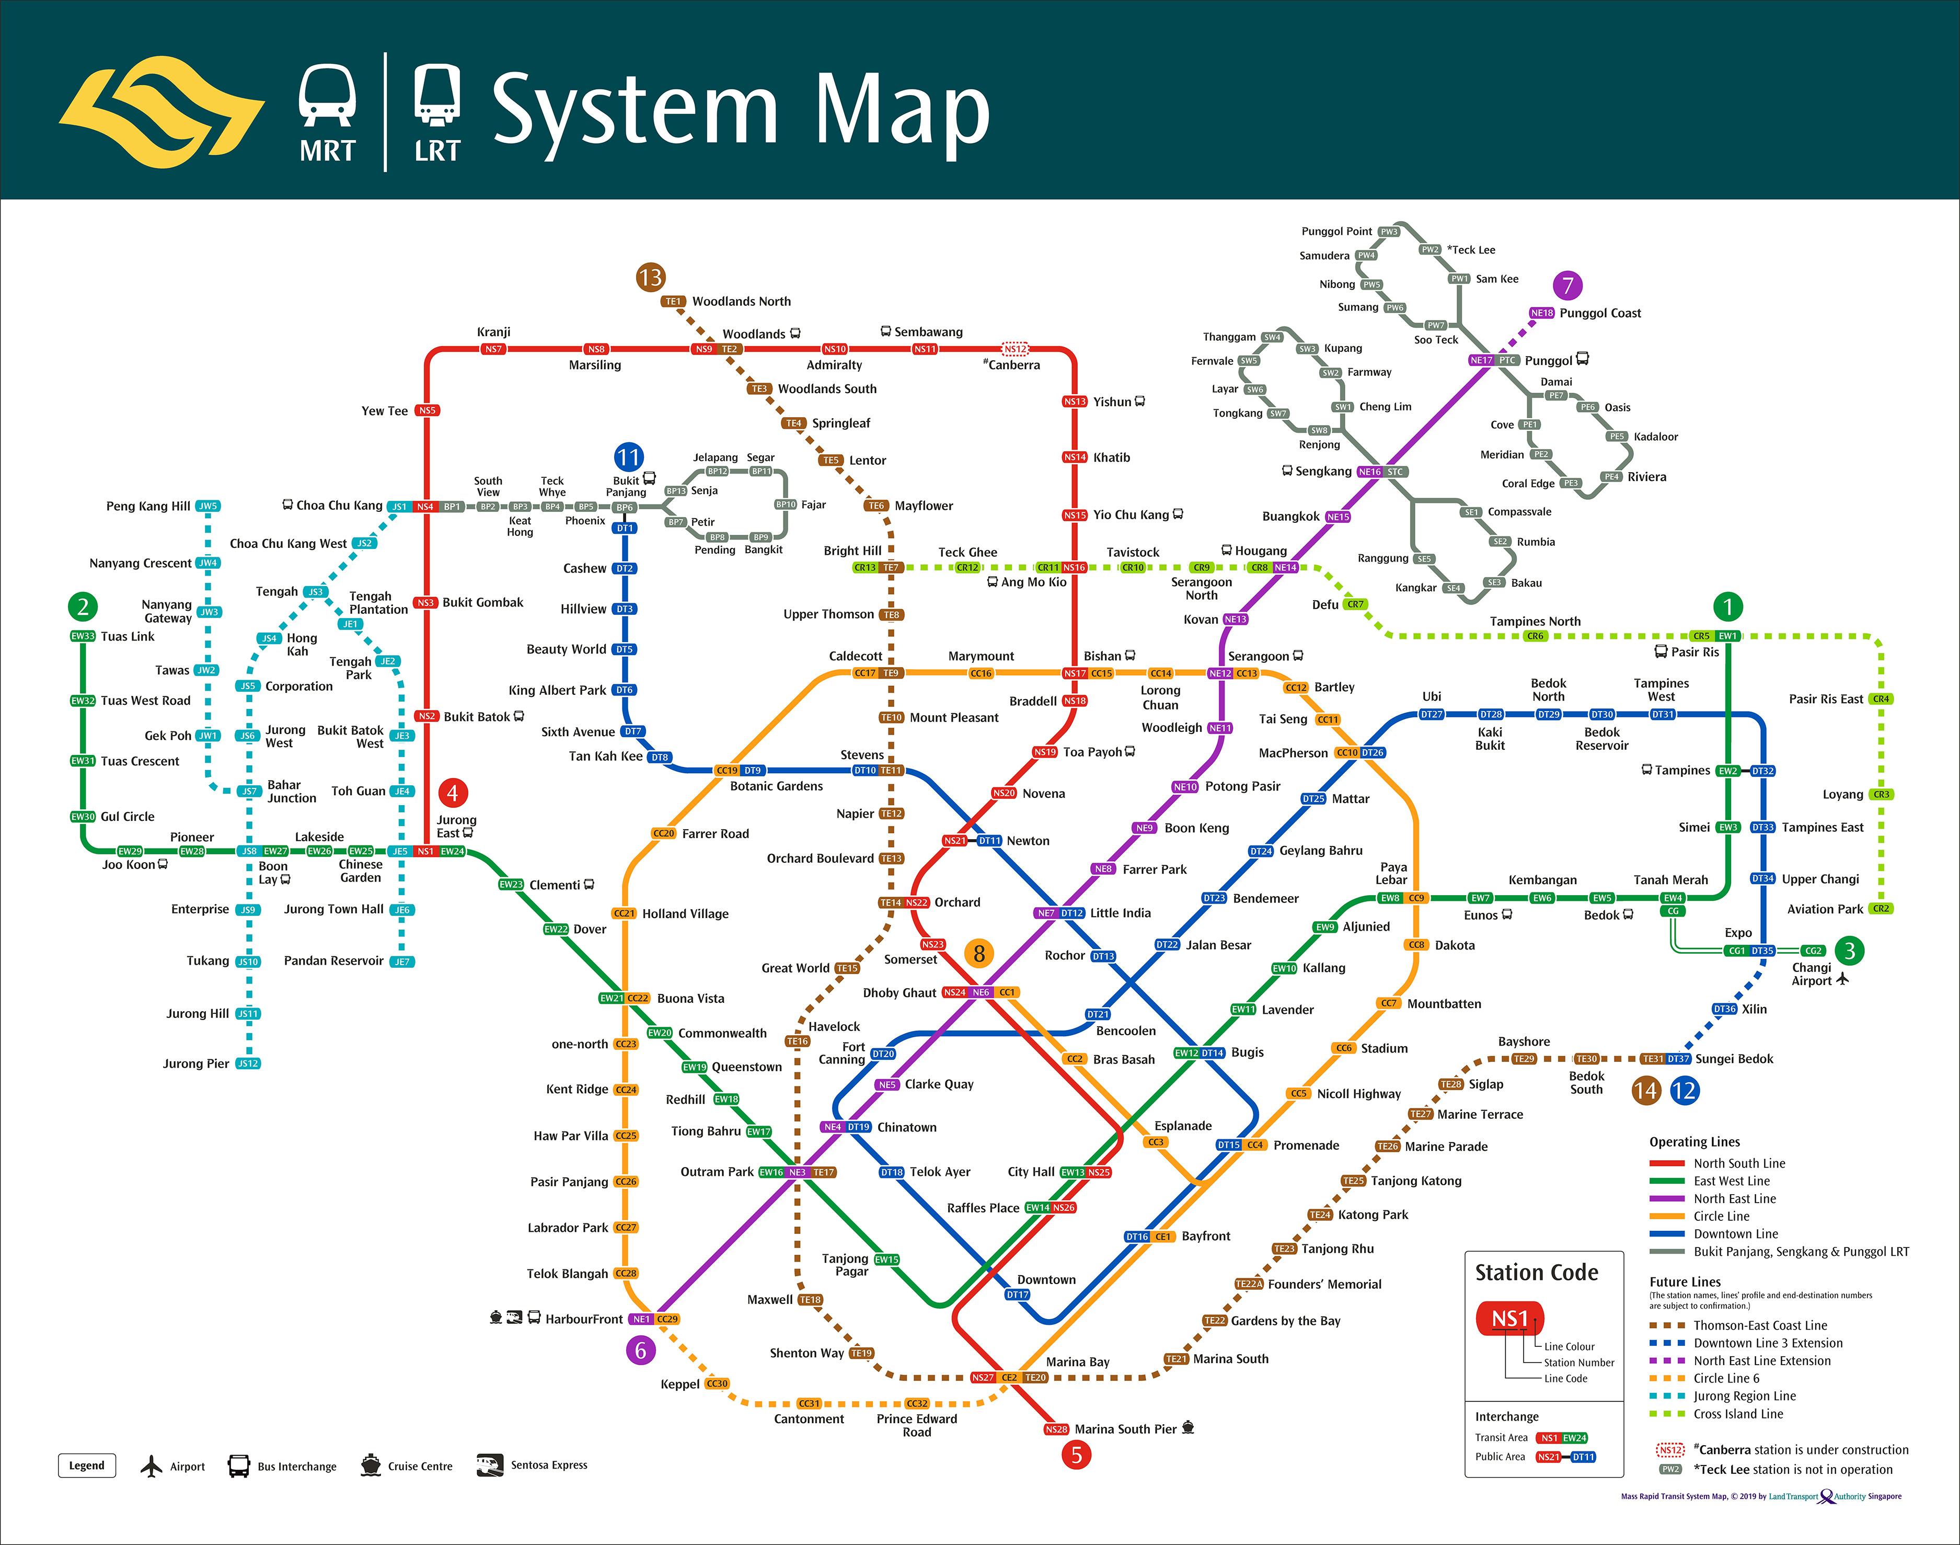
Connectivity For All
Singapore’s booming MRT Network has long been a priority for the nation
Since its conceptualisation in 1972, the MRT system has played an integral role in citizens’ lives
2030
Notes:
Since its conceptualisation in 1972, the MRT system has played an integral role in citizens’ lives, with our system map constantly evolving and seeing more than 5 renditions over the past 30 years.

Slide 10
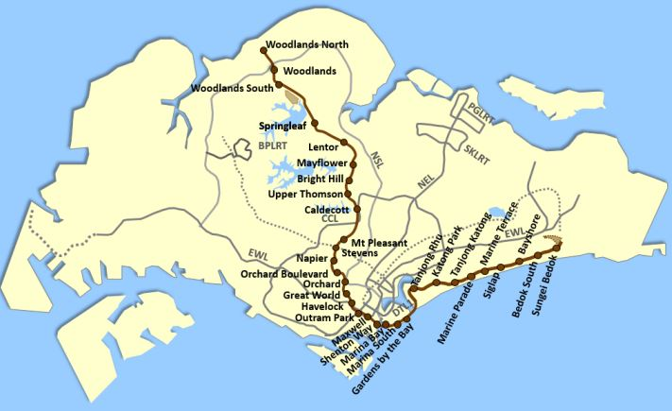
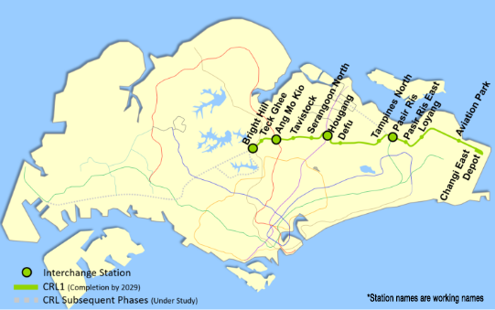
Connectivity For All
Singapore’s booming MRT Network has long been a priority for the nation
With 3 new lines and 3 more
extensions to be completed by 2030…
Notes:
With 3 new lines and 3 more extensions to be completed by 2030…

Slide 11


Connectivity For All
Singapore’s booming MRT Network has long been a priority for the nation
With 3 new lines and 3 more
extensions to be completed by 2030…
… and rising passenger numbers with easing COVID restrictions
>2.2 million
MRT passengers per day
~9% increase
in daily MRT passengers since 2020
Notes:
… and rising passenger numbers with easing COVID restrictions

Slide 12
Connectivity For All
Singapore’s booming MRT Network has long been a priority for the nation
With 3 new lines and 3 more
extensions to be completed by 2030…
… and rising passenger numbers with easing COVID restrictions
the speed and growth of Singapore’s MRT System is undeniable.
>2.2 million
MRT passengers per day
~9% increase
in daily MRT passengers since 2020
Notes:
the speed and growth of Singapore’s MRT System is undeniable.

Slide 13
Building a robust network
Challenges faced in enhancing MRT services
However, the immense scale of the system threatens to strain our already limited resources
Notes:
However, the immense scale of the system threatens to strain our already limited resources. We thus foresee multiple challenges that need to be ameliorated as we attempt to build a robust MRT network, enhancing existing services.

Slide 14
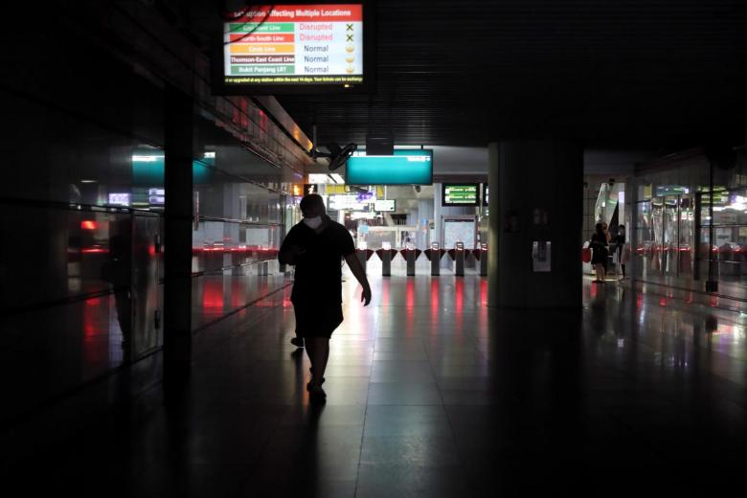
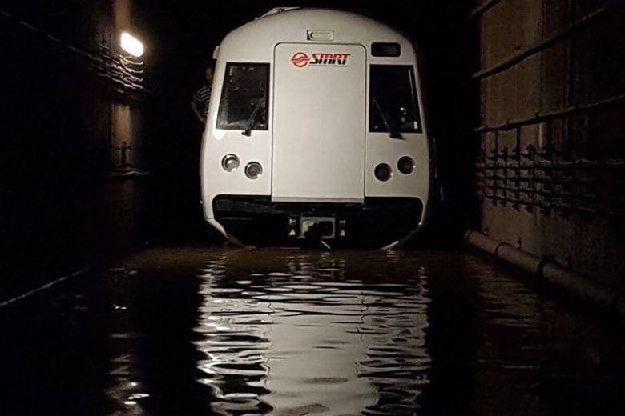
Building a robust network
Challenges faced in enhancing MRT services
However, the immense scale of the system threatens to strain our already limited resources
1
Unexpected Delays
2017 Bishan Tunnel Flood
Train Faults
&
Natural Events (flooding)
------
Rerouting of trains & personnel
>10 major train breakdowns have occurred since 2011
Notes:
Firstly, there will be issues regarding unexpected delays, timely and efficient rerouting of trains and manpower would be essential in such a scenario. Train faults and flooding are not new to Singapore.

Slide 15
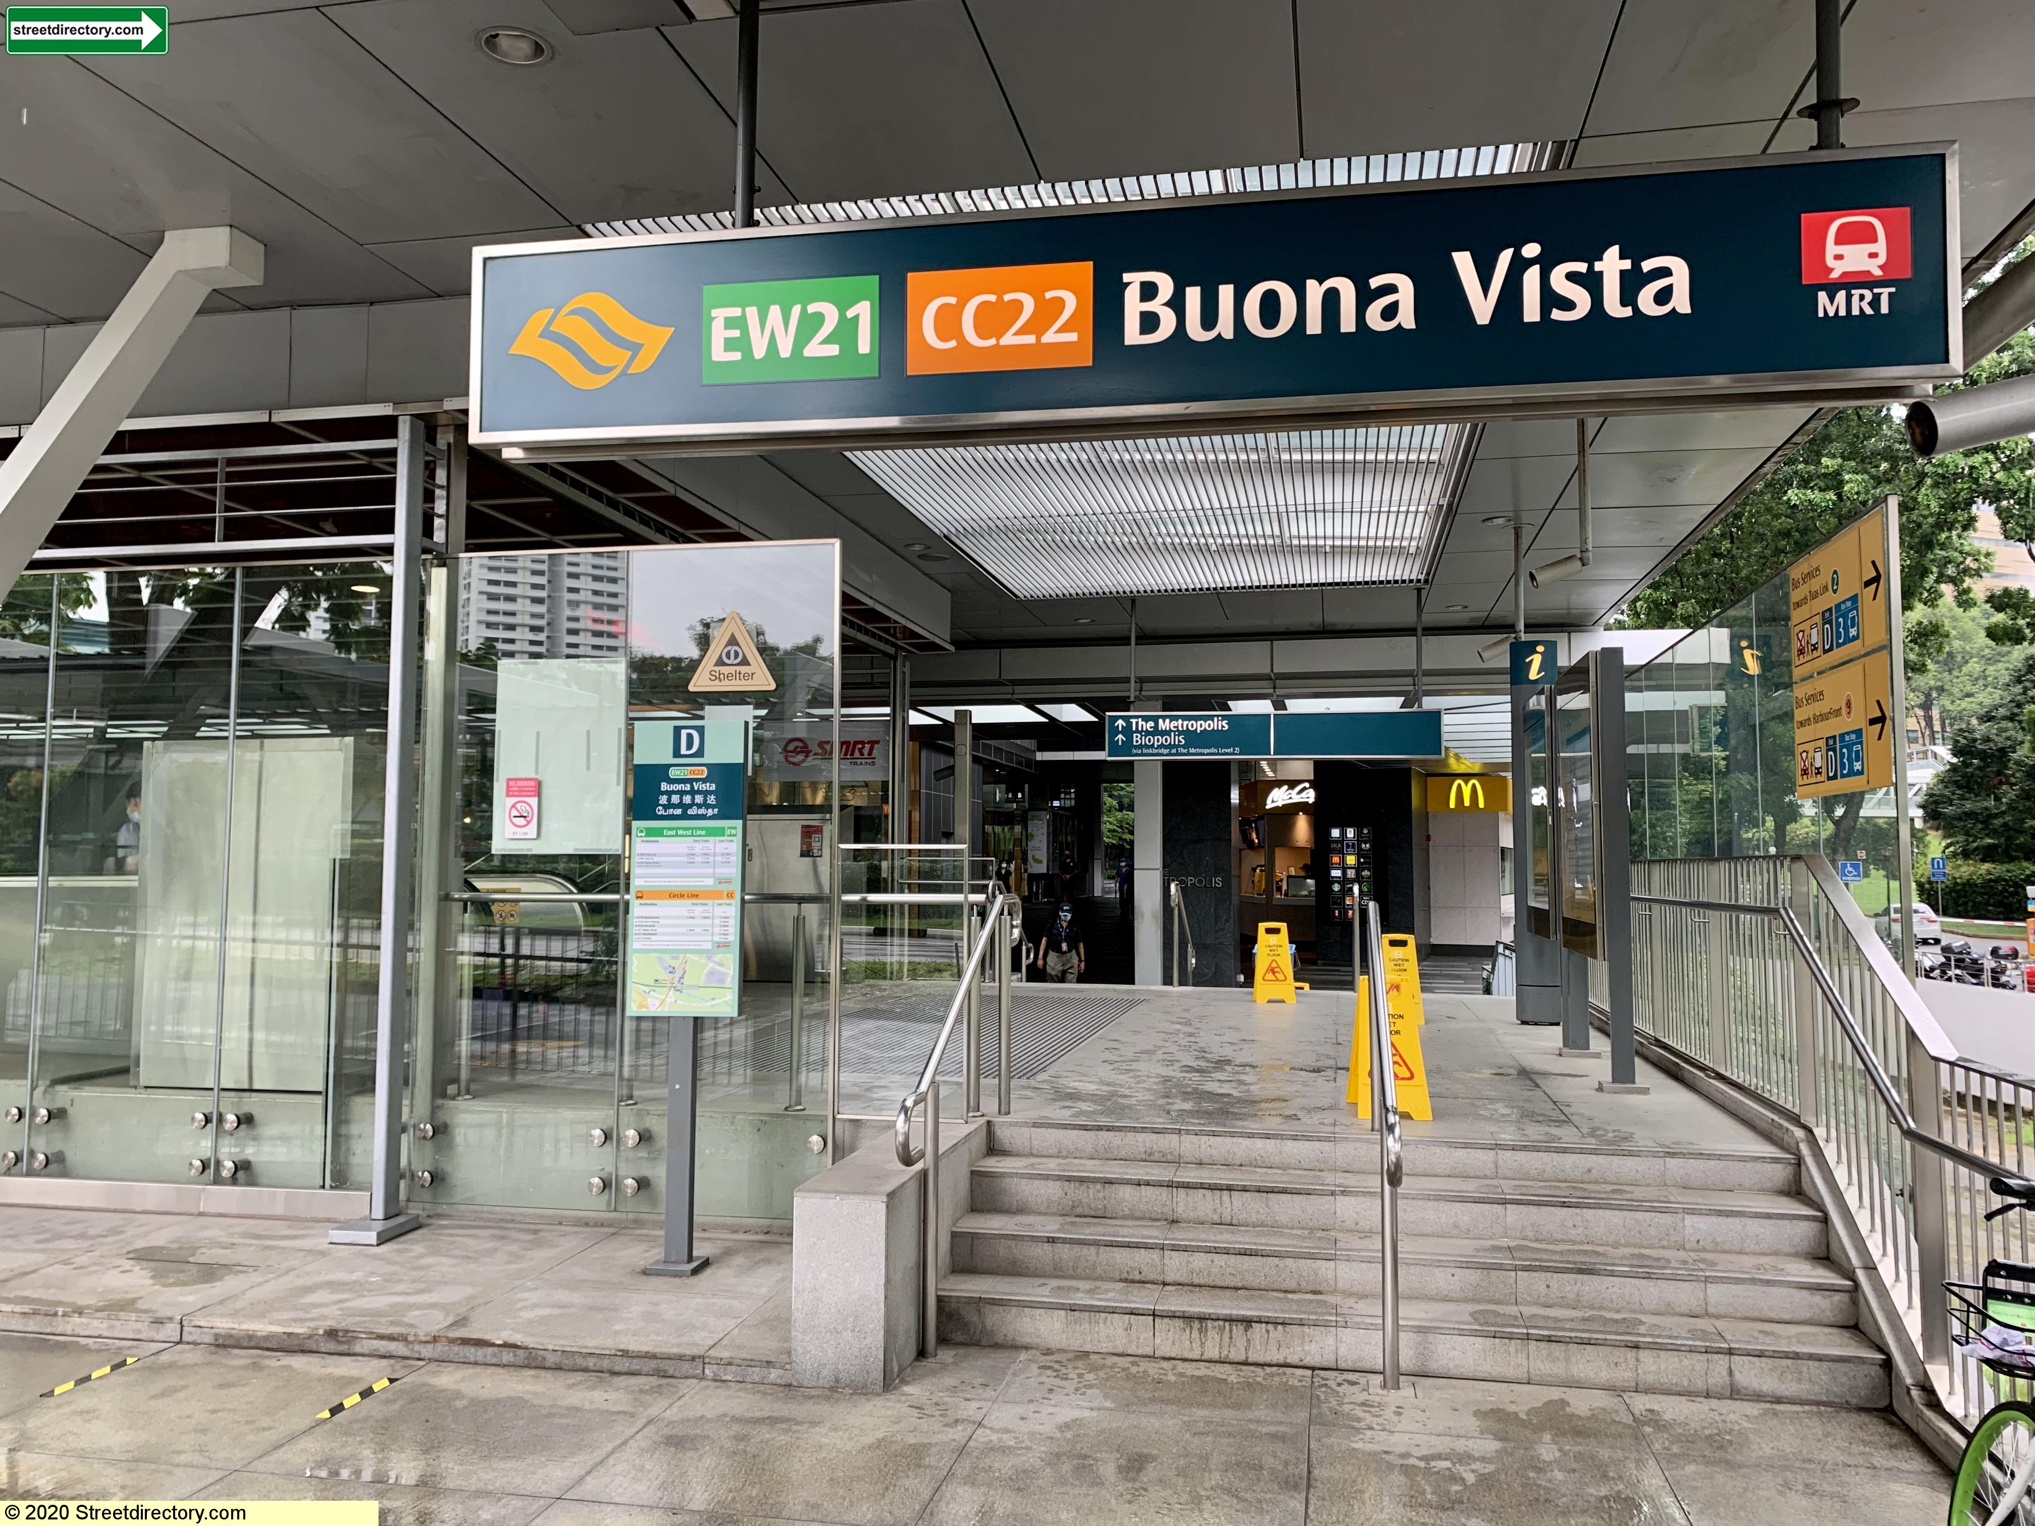
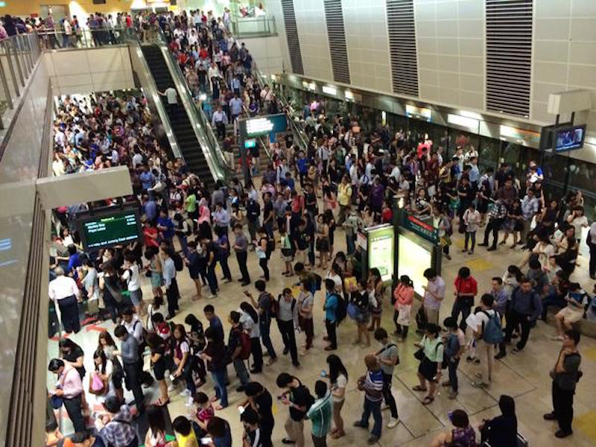
Building a robust network
Challenges faced in enhancing MRT services
However, the immense scale of the system threatens to strain our already limited resources
2
Stress
Nodes
Overcrowded
&
Overworked
Stations
------
Modifying train frequencies
Notes:
Secondly would be the mitigation of stress nodes. These are overcrowded and overworked stations that often face heavy crowds and footfall.

Slide 16

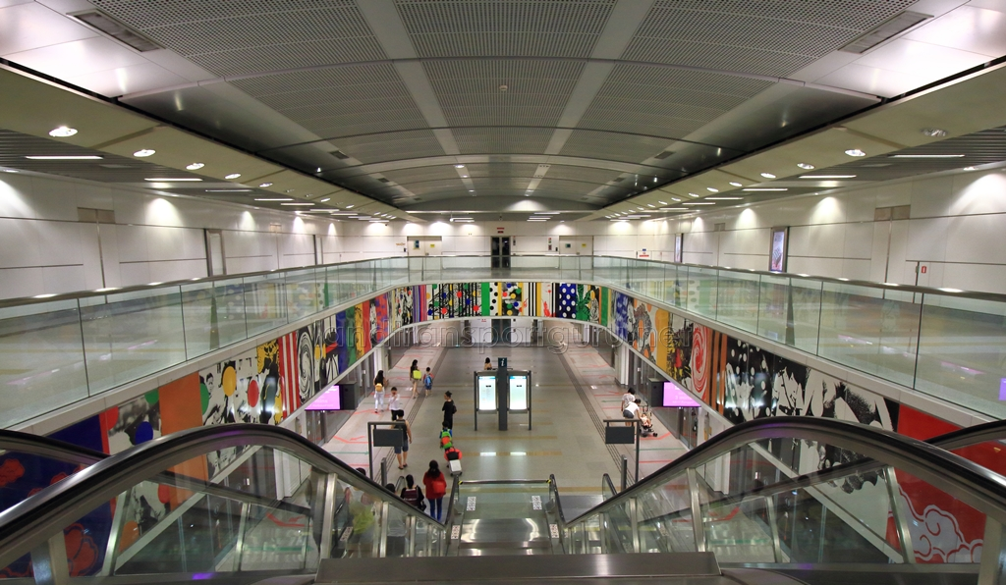
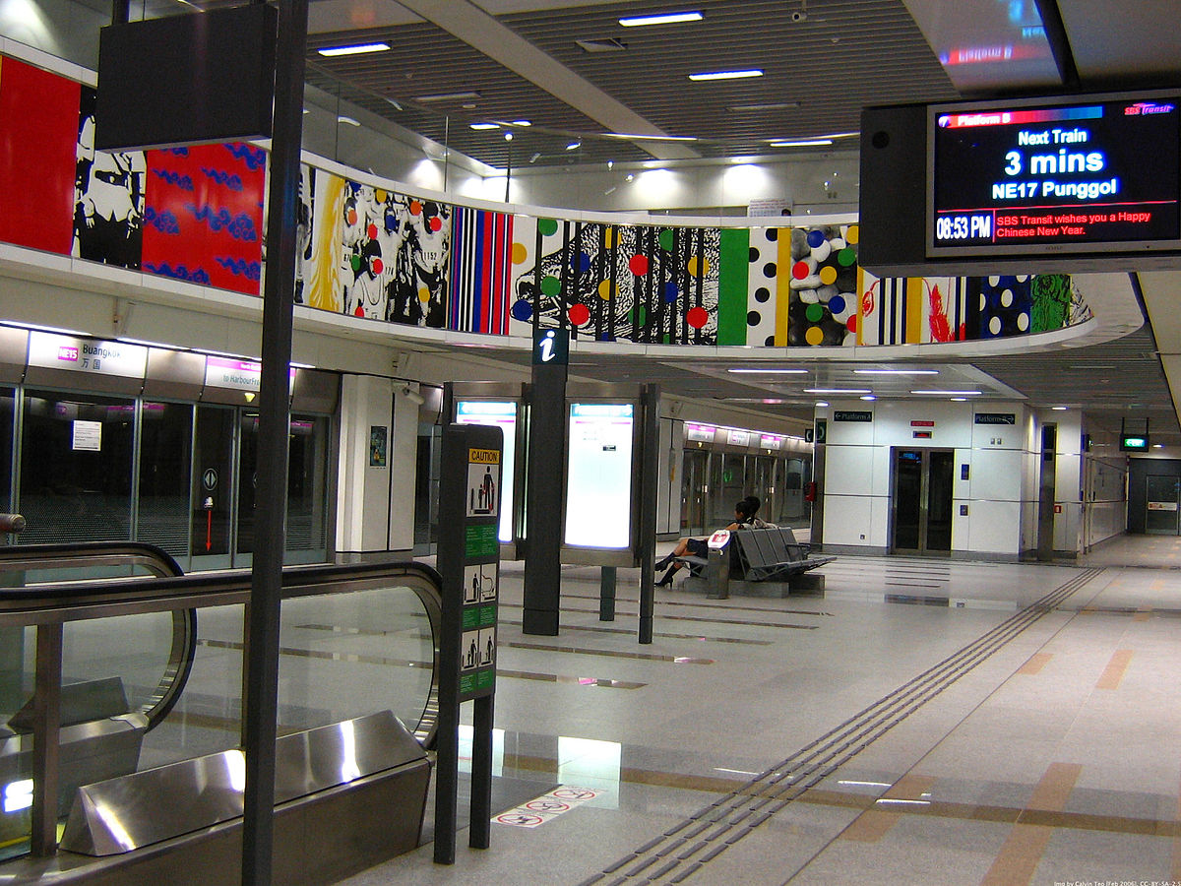
Building a robust network
Challenges faced in enhancing MRT services
However, the immense scale of the system threatens to strain our already limited resources
3
Misallocated Resource
Buangkok MRT
“White Elephant” Incident
Redundancies
&
Underutilised facilities
------
Enhanced resource planning and manpower allocation
Notes:
Thirdly, is misallocated resources. There is an immense need to prevent the occurrence of redundancies that snowball into underutilised facilities. Examples include the buangkok mrt station “white elephant” incident a few years ago.

Slide 17
Solutions & Hypothesis
How we plan to bridge the gap
We seek to analyse existing MRT stations to model passenger traffic at future stations
for enhanced urban planning strategies
3
Residential
Work
Commercial
MORNING
MORNING
IDENTICAL TRENDS
WITH WORK
Gentler & Later peaks
Flexible hours & Later start time
Constant crowds
throughout the day
High Tap In
Low Tap Out
Low Tap In
High Tap Out
EVENING
EVENING
Low Tap In
High Tap Out
High Tap In
Low Tap Out
Notes:
Hence, to ameliorate these challenges, we seek to analyse existing MRT stations to better model passenger traffic at future stations for enhanced urban planning strategies.
We hypothesis the clustering of stations into 3 key categories - residential, work and commercial.
We predict high tap in and low tap out rates in the morning for Residential, and the converse at night.
Work and commercial will have the opposite trends, with low tap in and high tap out in the morning, and high tap in, low tap out rates at night.
We predict that commercial stations will see gentler and later peaks, with the flexible hours and later start time of retail stores, and the constant flow of traffic throughout the day.

Slide 18






Executive Summary
Project Workflow
Problem Definition
Exploratory Data Analysis
& Visualisation
Insights & Trends
Data Cleaning & Preparation
Machine Learning Modelling
Impact & Recommendations
Notes:
With our hypothesis and problem statement in place, our team then adopted the following project workflow which we will now walk you through, starting with the cleaning and preparation of our data.

Slide 19
Data Cleaning & Preparation

Slide 20
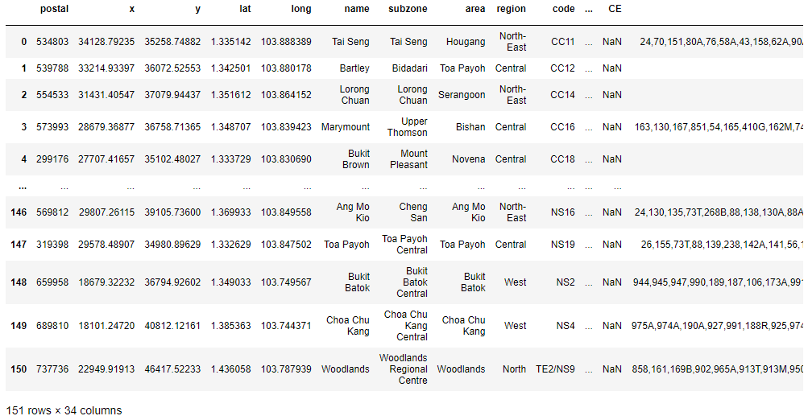
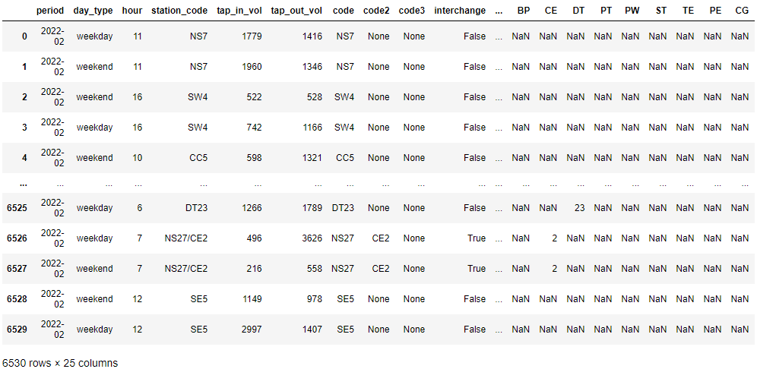
Dataset Overview
2 types of key data on MRT train station
1. Static data
Location based info
Supporting amenities
2. Dynamic data
Time & location based info
No. of tap in/out

Slide 21





Data Augmentation
How we built and collected the data from various APIs
‘Pure’ data
Add geo data
Add geo features/amenities
Raw list of station & station code
Restrict scope to MRT stations only
Coordinates & postal code
Subzone
Planning Area
Region
Population
Bus services
Amenities (malls, supermarkets, businesses)
Notes:
Originally from LTA APIs – but limited in features
Where the additional data came from
We had to CREATE OUR OWN DATA AND PICK OUR OWN FEATURES
BUILT EVERYTHING FROM SCRACTH
PIONEER GNEERATIONS
d5Ai hiPpi3szxc

Slide 22
Data Augmentation
How we built and collected the data from various APIs
Why add new data?
New features can better predict
future passenger traffic at future stations
‘Pure’ data
Add geo data
Add geo features/amenities
Raw list of station & station code
Restrict scope to MRT stations only
Coordinates
Subzone
Planning Area
Region
Population
Bus services
Amenities (malls, supermarkets)
Notes:
Originally from LTA APIs – but limited in features
Where the additional data came from
We had to CREATE OUR OWN DATA AND PICK OUR OWN FEATURES
BUILT EVERYTHING FROM SCRACTH
PIONEER GNEERATIONS
d5Ai hiPpi3szxc

Slide 23
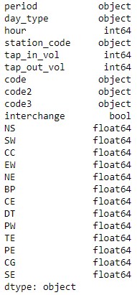
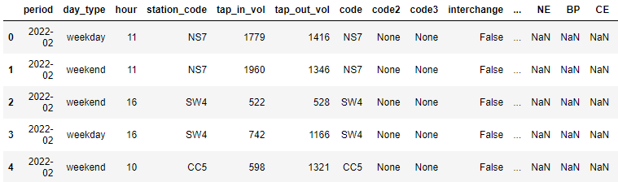
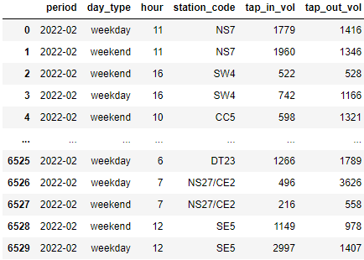
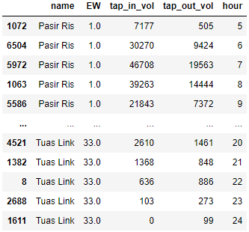
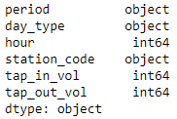
Data Manipulation
Create new columns for easier search & sort
1. Original Dataset
2. Add new descriptive cols
Data types not rank/search friendly
Station code should be categorical, not numerical
hour : final op hour should be 24, not 0
Change dtype
Break down station code into individual lines (numerical)
Add interchange bool
3. Easier data manipulation
Data can be sorted by lines for line-based analysis
Notes:
Split into op v future (train v test)
Filling in missing data
Removing NA rows (e.g. bidaddari)

Slide 24
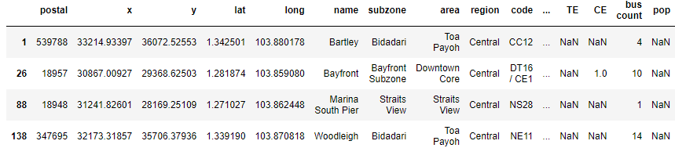

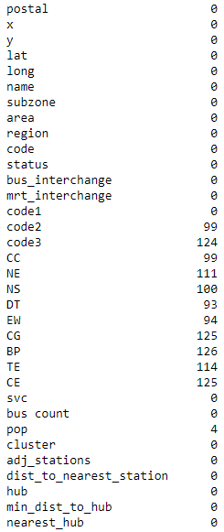
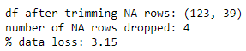
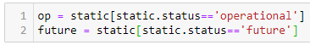
Data Cleaning
Splitting data & removing NA rows
Separating train/test from validation data
Removing NA rows
All stations
Nan values arose from incomplete data source
May skew the model, hence removed
Operational stations
Future
stations
Used for ML training
Used to predict trends at new stations
Checked to ensure that removal does not significantly affect train/test dataset

Slide 25


Additional Data
Sourcing possible predictors
1
Shopping Malls
2
Supermarkets
3
ACRA Registered Businesses
Grocery
Mall
Coordinate data from onemap
Wikipedia
↓
Mall Names
↓
Query
↓
Postal Codes
↓
Query
↓
Postal Codes
↓
Query
dynamic
Change from hour 0 to hour 24
Remove LRT data
Adding interchange col etc
Split from single station code to indiv lines

Slide 26
Exploratory Data Analysis

Slide 27
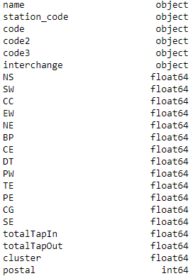
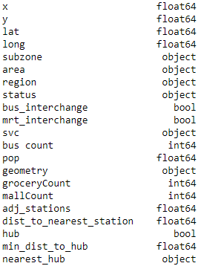
Exploring static dataset
Data types
Original data
Breaks down interchange station codes into separate codes for each line
Geolocation data
URA planning boundaries
Operational/Future
Engineered data
Order of station on each line
If not found on line, Nan is used
Features wrt proximate stations
Average from dynamic dataset
Cluster type (0, 1, 2)
Ranges from 5 (5am op start) to 24 (12am op end)

Slide 28
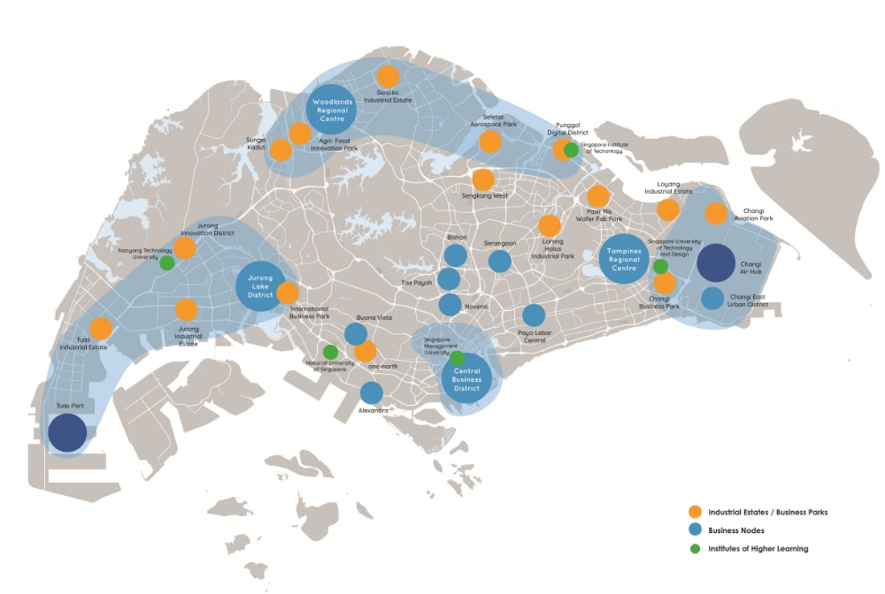
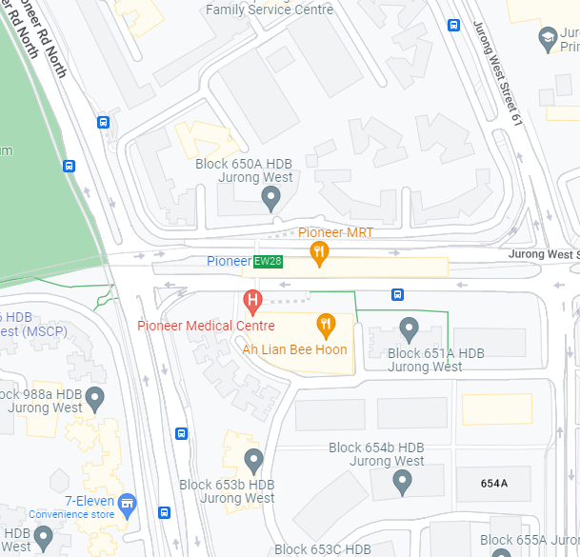
Exploring static dataset
Defining metrics that measure interconnectivity
Hub
svc & bus count
svc
Number of unique bus services for a bus stop within 250m radius of an MRT station (Haversine Distance)
250m
bus count
len(svc)
adj_stations & dist_to_nearest_station
URA Master Plan 2030
Jurong East
Woodlands
Tampines
Raffles Place (CBD)
adj_stations
Number of MRT stations within 2km radius of an MRT station (Haversine Distance)
dist_to_nearest_station
min(distance to all other stations)

Slide 29
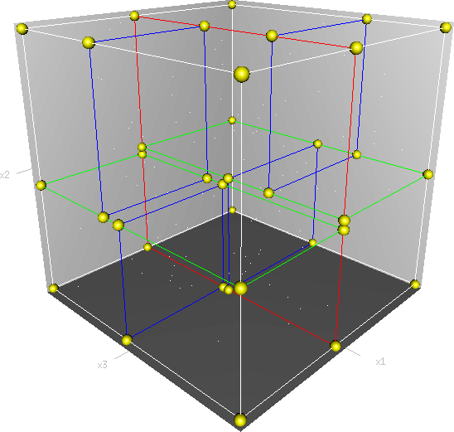
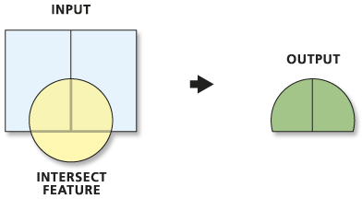
Geospatial Data Processing
k-d Trees
Spatial Intersections
Grocery
Mall
Coordinate data from onemap
dynamic
Change from hour 0 to hour 24
Remove LRT data
Adding interchange col etc
Split from single station code to indiv lines
Notes:
The KD tree allows for k-dimensional points to rapidly look up the nearest neighbors of any point. The general idea is that the kd-tree is a binary tree, each of whose nodes represents an axis-aligned hyperrectangle. Each node specifies an axis and splits the set of points based on whether their coordinate along that axis is greater than or less than a particular value. The tree can be queried for the r closest neighbors of any given point which is used to provide minimum distance towards nodes near an MRT station.
Spatial intersection is a similar idea, but instead of finding the nearest node, instead the focus is on finding the total number of nodes at a point instead.

Slide 30
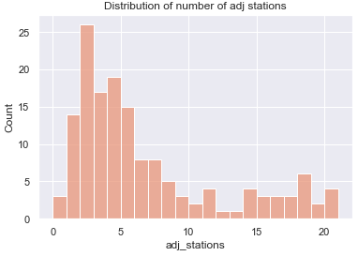
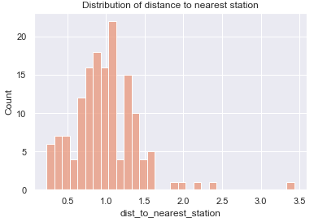
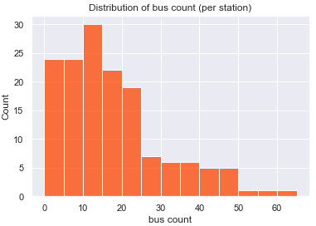
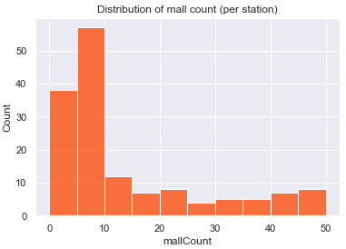
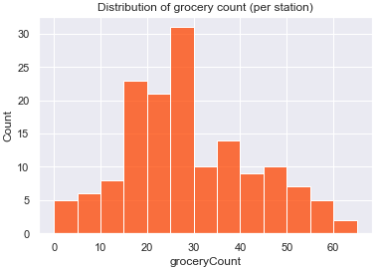
Exploring static dataset
Distribution of numerical data

Slide 31
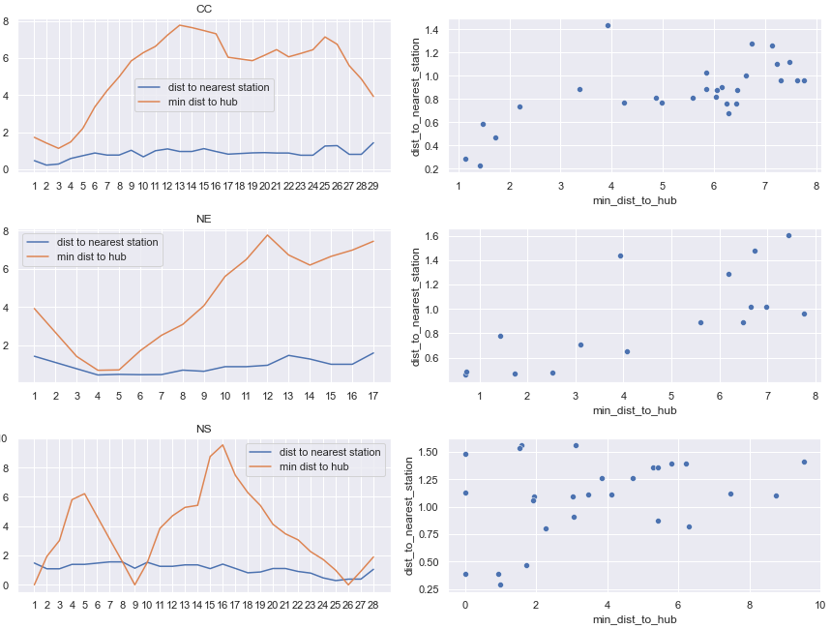
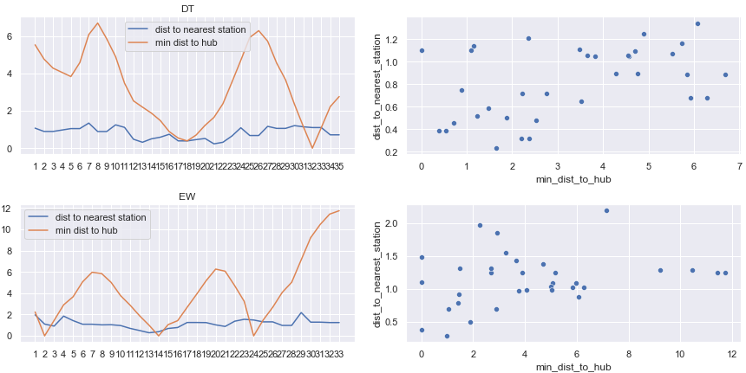
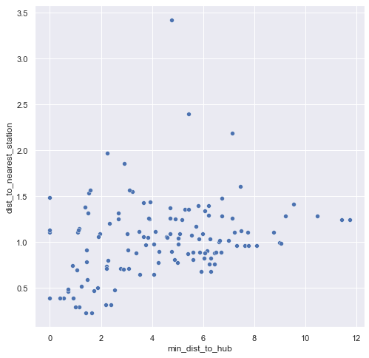
Exploring static dataset
Analysing relationship on metrics affecting station density
Operational stations (sorted by line)
Operational stations
Potential hypothesis for exploration
Level of interconnectivity of a station affects the distribution and type of passenger traffic

Slide 32
Exploring dynamic dataset
Data types
weekday / weekend
Original data
Ranges from 5 (5am op start) to 24 (12am op end)
Breaks down interchange station codes into separate codes for each line
Engineered data
Order of station on each line
If not found on line, Nan is used

Slide 33
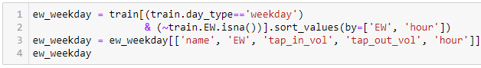
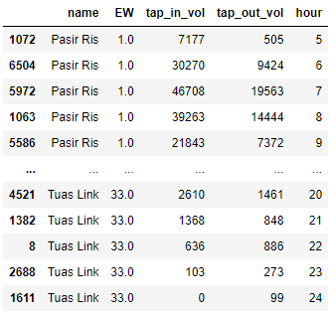
Exploring dynamic dataset
Trend analysis by line
Sample analysis on EW line, weekday using pivot table

Slide 34
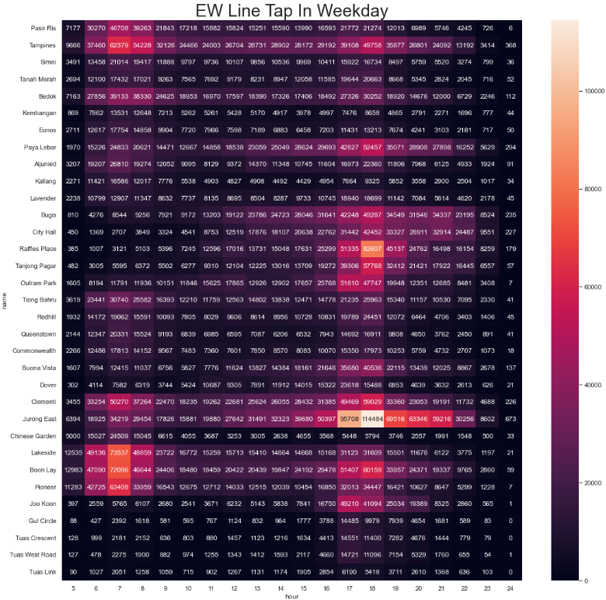
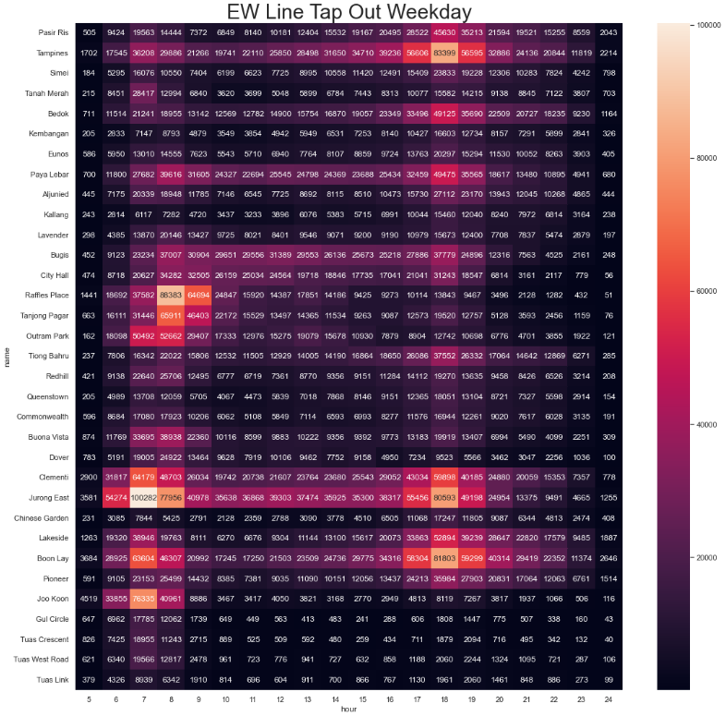
Exploring dynamic dataset

Slide 35
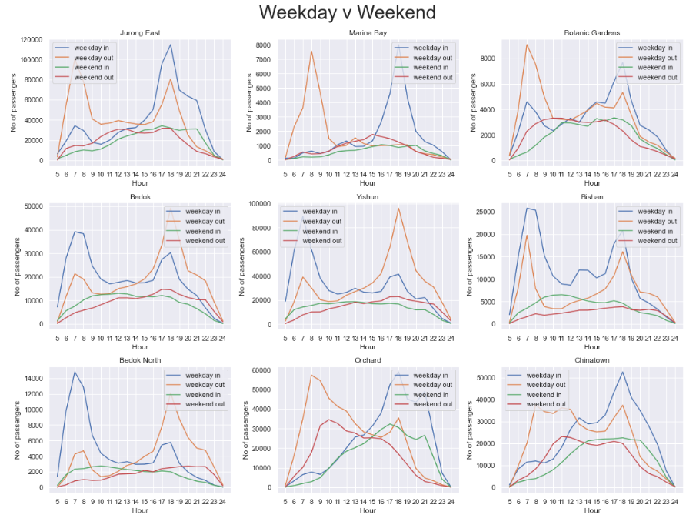
Exploring dynamic dataset
Trend analysis by station
Potential hypothesis for exploration
Different type of stations have different peaks and patterns
Weekend patterns differ from weekday patterns

Slide 36
Potential trends to explore
We found these interesting observations from earlier….
It kinda supports our hypothesis
Therefore we will explore further in this direction
Need to map trends in dataset 2 to each station to dataset 1
This can be a new feature to gauge each station
Need to find out exactly which other feature to compare
Find out best feature to predict

Slide 37
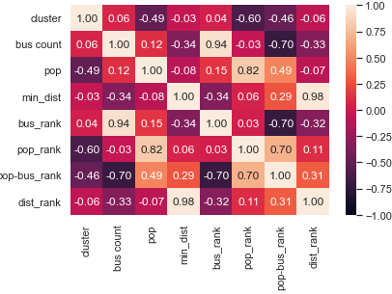
Initial attempt during EDA
Uwu sad la sial
Poor corr -> we need feat engineering in hope of finding a better way to predict using better features
Some other problems we face
eg limited number of features, how to better measure?

Slide 38
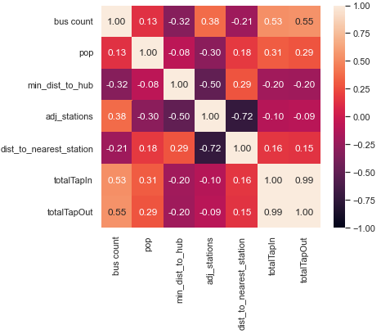
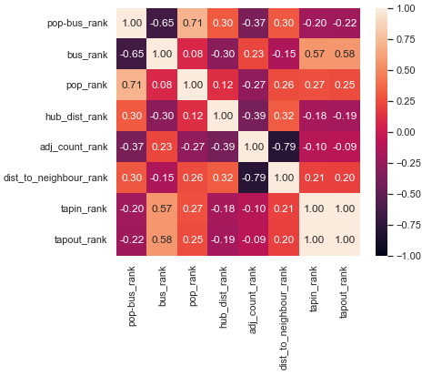
Feature Engineering
Ranking
Raw features
Ranked features
Derivation
Features are ranked within column
Standardized to (0,1)
Impact
Easier to manipulate for addition/subtraction of 2 variables (with different scales)
Improves correlation
Better predictor as features for model training
Notes:
Ranking columns – why they are useful
Standardisation
Clustering
Brief overview
Cluster stations, using clustering to predict which cluster the new station would fall into and consequently, predict passenger traffic and flow throughout the day

Slide 39
ML
Modelling

Slide 40
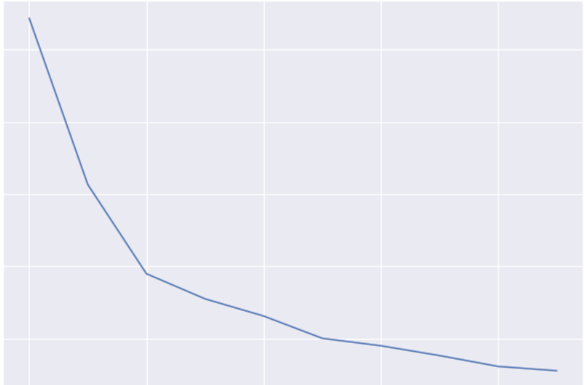
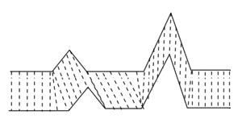
Clustering
Time Series
Dynamic Time Warping
Ideal Cluster Value
DTW/SOFT DTW
Why Euclidean is bad
How to get DTW with diff pop size (percent in/out)
Kmeans
Elbow mthd (fast game this)
Show pics of clusters in damning positions
Elbow @ Cluster = 3
No. of Clusters
No. of Clusters
Notes:
It is likely different shapes of the time series data represents different districts a station serves. We attempt to cluster them with kmeans. First off, we scaled each station to show percentage of the total volume in. This allows the clustering technique to cluster places that have a sizable difference in passenger volumes, even though they might perform similar functions. \
Secondly, we use a dynamic time warping algorithm to be the distance function. Compared to traditional Euclidean distances, time differences in peaks and throughs are more liniently dealt with
With this method of clustering, we set to compute not only the clusters, but also the number of clusters using the elbow method. As seen in the graph of inertia from a cluster, we can find that an optimal number of clusters lies at 3.

Slide 41
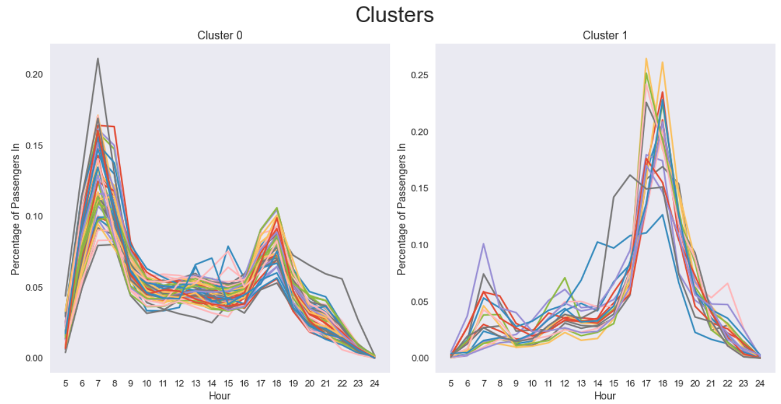

Clusters
1
2
3
Percentage of Passengers In
DTW/SOFT DTW
Why Euclidean is bad
How to get DTW with diff pop size (percent in/out)
Kmeans
Elbow mthd (fast game this)
Show pics of clusters in damning positions
Hour
Notes:
Having computed the clusters, we can immediately see trends in the tap in data.

Slide 42


Clusters
In
Out
1
2
3
DTW/SOFT DTW
Why Euclidean is bad
How to get DTW with diff pop size (percent in/out)
Kmeans
Elbow mthd (fast game this)
Show pics of clusters in damning positions
Percentage of Passengers In/Out
Hour
Notes:
Using the cluster centers for analysis, we can start to explain the shapes of each of the graphs.

Slide 43


Cluster 1
In
Out
DTW/SOFT DTW
Why Euclidean is bad
How to get DTW with diff pop size (percent in/out)
Kmeans
Elbow mthd (fast game this)
Show pics of clusters in damning positions
Percentage of Passengers In/Out
Hour
Notes:
The first cluster has high passenger volumes into the station in the morning, which decreases throughout the day. The tap out volumes take an inverse of this, being lower in the earlier part of the day before rising rapidly during peak hours. Because of this, we can easily say that cluster 1 represents a station serving a residential district. Residents flooding into a station in the morning, and returning after work is over is easily shown in the graph.
Futher analysis of stations that fall under this cluster show that this cluster is indeed residental, with places like Bedok, houghang and simei.

Slide 44


Cluster 2
In
Out
DTW/SOFT DTW
Why Euclidean is bad
How to get DTW with diff pop size (percent in/out)
Kmeans
Elbow mthd (fast game this)
Show pics of clusters in damning positions
Percentage of Passengers In/Out
Hour
Notes:
Cluster 2 is far different, firstly in the sense that passengers OUT of the station are more frequent in the morning, and the inverse at night. Further more, the peaks are very distinct, and there are effectively 1 peak for passsengers in and out. This is likely due to these places being purely industrial or work related, with very few residential estates nearby. For example, the stations the CBD fir this trend

Slide 45


Cluster 3
In
Out
DTW/SOFT DTW
Why Euclidean is bad
How to get DTW with diff pop size (percent in/out)
Kmeans
Elbow mthd (fast game this)
Show pics of clusters in damning positions
Percentage of Passengers In/Out
Hour
Notes:
The third cluster bears resemblance to the second cluster, with passengers mostly leaving the station in the morning and entering in the evening. However, while peak hour peaks are apparent, it is not as substantial, with passenger counts relatively high through out the day. This might be indicative of a district that serves a mostly industrial purpose, but has some residential districts in it as well. For example, bartley is a mixed use district with schools and some industries around the station, as well as a large number of condos which can serve to explain the tertiary peaks.

Slide 46

Why we tried these methods -> we are using numerical to predict categorical -> thus there is a restricted range of methods that we can employ
Talk about our data type
Classification Methods
Failure of Decision Tree
Notes:
With these cluster, we sought to predict the clusters using all of the data that we had scraped, from population density, to bus count, to number of malls, groceries and business in the area. All these data served to form a predictive variable for the clusters, our response variable. Clusters are a form of categorical data, and thus predicting it with numerical data initially lead us to a decision tree.

Slide 47
Why we tried these methods -> we are using numerical to predict categorical -> thus there is a restricted range of methods that we can employ
Talk about our data type
Classification Methods
Failure of decision tree
Notes:
However, the accuracy of the decision tree was poor

Slide 48



Why we tried these methods -> we are using numerical to predict categorical -> thus there is a restricted range of methods that we can employ
Talk about our data type
Classification Methods
Why the decision tree failed
Notes:
Looking through our variables, we attributed this to the fact that much of our data had to significant divisions. We needed a more robust way of predicting categorical data.

Slide 49


Why we tried these methods -> we are using numerical to predict categorical -> thus there is a restricted range of methods that we can employ
Talk about our data type
Classification Methods
Methods of predicting categorical data
$$P(x_{i})=\frac{1}{1+{{(e}^{α+βx})}^{−1} }$$
Notes:
We initially started by looking at models that predicited fuzzy logic, with logistic regression and linear discriminant analysis. Both methods had the same functional form, the sigmoid curve, only differing in the estimation of coefficients.
However, the results of the two methods are really close when the sample size is large. The main differences can be observed for small samples, as their distributions vary too much for the LR to be able to give good results. On the other hand, LDA assumes normality. The errors it makes in prediction are only due to the errors in estimation of the mean and the variance on the sample. To conclude, even though LDA is a constantly better method when the normality assumptions are met, the differences between the methods become negligible with a sample size of 50 and more, when the methods differently allocate only about 0.5% of the cases.

Slide 50
Comparison table
Tried:
Linear regress
Des tree
Dynamic partion (idt its called this but I lazy alt tab)
KNN
Success:
Log reg
Compare model accuracies
 | Decision Tree | Logistic Regression | Linear Discriminant Analysis
Train | 0.67326 | 0.58415 | 0.71287
Test | 0.57692 | 0.73076 | 0.73077
Notes:
We see in this case LDA has a much higher train and test accuracy than logistic regression, and was ultimately the model we choose to use for our final predictions..

Slide 51
Insights & Trends

Slide 52



Clustering Interpretation
Cluster correlation matrix
Cluster 1
Cluster 2
Cluster 3

Slide 53



Clustering Interpretation
Cluster samples
Cluster 1
Cluster 2
Cluster 3

Slide 54
Clustering Interpretation
Cluster pattern recognition
Cluster 1
Cluster 2
Cluster 3
Residential centric
Morning high in
Evening high out
Work centric
Morning high out
Evening high in
Weak in/out correlation
Mixed use (work & residential)
Morning high out
Evening high in
Strong in/out correlation

Slide 55
What our data means
Attach meaning to our results
Trend based
Indiv highlights
What does each cluster represent
Eg cluster 1 is residential cos residential is like this and the graphs of cluster 1 is also similar
Back up with results from the df ranking etc.
Anomalies
Eg station X should be cluster A not B, but ML model says B, so …
Add in parallel comp w real life
Highlight a few special cases that are worth mentioning

Slide 56
Impact & Solution

Slide 57
Applications of findings
Map out each new station on TEL
Eg GTB
Solutions/Recommendations
Better manpower allocation
Train frequency
Number of buses to serve the area
Better manage redundancies in terms of infrastructures
Number of exits
Trade off between managing large crowds at surge time VS emptiness every time else
Redundancy = extra money involved

Slide 58

Solving the Problem
Supporting Urban Planning Strategies
Model output on validation set
Applying prediction to new stations on Thomson East Coast Line Stage 3 (TEL)
Can better predict the station types
And thus the features/manpower required to support the station design/maintenance

Slide 59



Solving the Problem
Supporting Urban Planning Strategies
Enhanced
Manpower
Allocation
Planning Train Frequency
Designing
Bus Routes
Minimising Infrastructural Redundancies
Notes:
To meet our goals of supporting urban planning strategies, our model enables LTA and all relevant agencies to better allocate manpower, plan train frequency, design bus routes and minimise infrastructural redundancies

Slide 60




Future extensions
Additional Datasets & Factors for Consideration
Festivities
Analysing annual data
(currently limited to 4 months)
Offices & Schools
Analysing a wider range of amenities
Passenger Journeys
Analysing the start and end points of user journeys
Passenger Types
Analysing the types of travellers and their respective habits
Notes:
Future extensions of our project could include the consideration of additional datasets like the following

Slide 61
Notes:
With these findings, we believe that we have successfully met our goal of supporting urban planning strategies, making the MRT system more robust to better serve the population. Thank you

Slide 62
Appendix
Comparison of Logistic Regression and Linear Discriminant Analysis: A Simulation Study Maja Pohar1 , Mateja Blas2 , and Sandra Turk3
Metodološki zvezki, Vol. 1, No. 1, 2004, 143-161

Slide 63



Mrt density

Slide 64


Bus counts

Slide 65

population

Slide 66

Population (squares)
&
Bus (circles)

Slide 67
KEY FEATURES
Topic sentence key point…
Topic sentence keypoint…
Supporting data

Slide 68
Topic sentence key point…
Topic sentence key point…

Slide 69
Topic sentence key point…
Topic sentence keypoint…
Topic sentence

Slide 70
Words … emphasis
Words … emphasis

Slide 71
Topic sentence
Topic sentece
conclusion
More than XX weeks
xx% of students
stats
stats
xxx applications
xx% of students
… sub conclusion
stats
stats
… sub conclusion

Slide 72
1
Xx
xx
2
Xx
xx
3
Xx
xx
Words
emphasis
Words
emphasis
Words
emphasis

Slide 73
Icon
placeholder
Icon
placeholder
words & emphasis
words & emphasis
words & emphasis
words & emphasis

Slide 74
header
conclusion

Slide 75
1
Xx
xx
2
Xx
xx
3
Xx
xx
4
Xx
xx
Words
emphasis
Words
emphasis
Words
emphasis
Words
emphasis

Slide 76
XX%
Stats & key points
XX%
Stats & key points

Slide 77





Slide 78



Slide 79





Slide 80




Slide 81


